Slide 1

Citizen science to map the Flora of Zurich region, Switzerland
Thomas Wohlgemuth WSL, Birmensdorf
Petra Bachmann WSL, Birmensdorf
Michael P. Nobis WSL, Birmensdorf
Andreas Keel Canton of Zurich
Michael Kessler Syst. Inst. Univ. Zurich
Reto Nyffeler Syst. Inst. Univ. Zurich
John H. Spillmann Syst. Inst. Univ. Zurich
Swiss Federal Institute for Forest, Snow and Landscape Research
WSL Birmensdorf, Switzerland

Slide 2
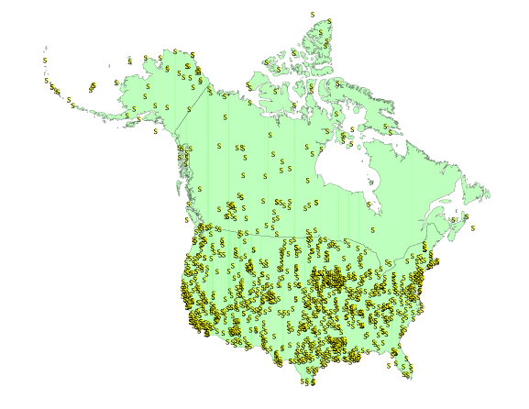
Local or regional floras
Floras with useful data:
ca. 4000 publications
➡ Different area sizes
Palmer et al. (2010)

Slide 3
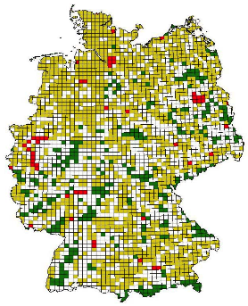
Floras in Europe
Germany
Grids of 20x20 km sizes
➡ Same area sizes, contiguous
Kühn et al. (20..)

Slide 4
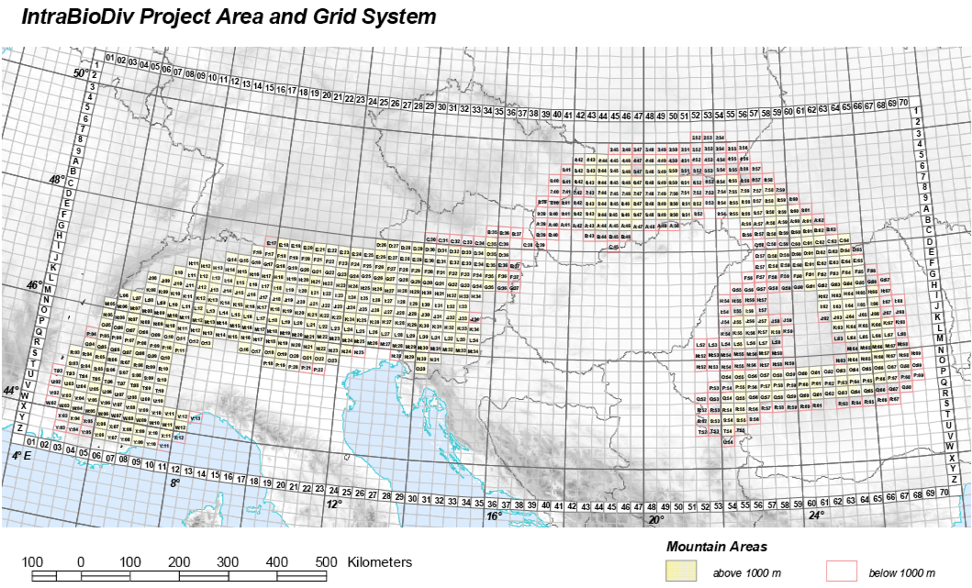
Floras in Europe
Alps & Carpathian Mts.
Grids of 20x20 km sizes
➡ Same area sizes, full census
Alvarez et al. (2010)
Taberlet et al. (in review)

Slide 5
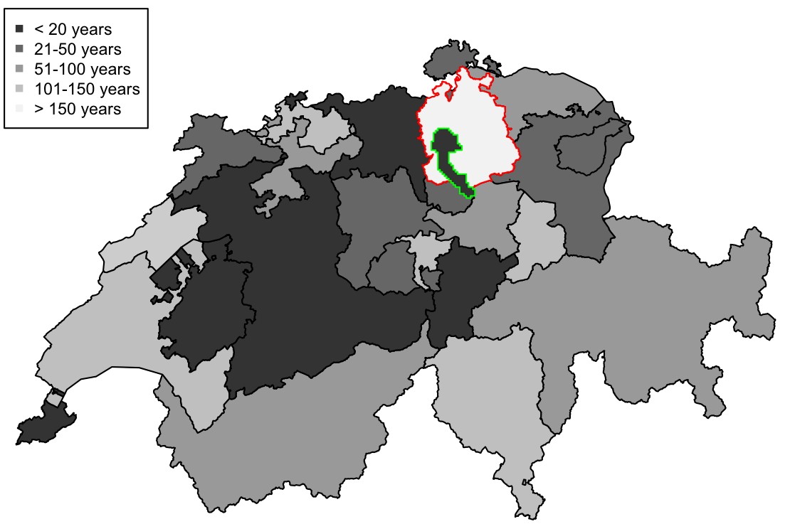
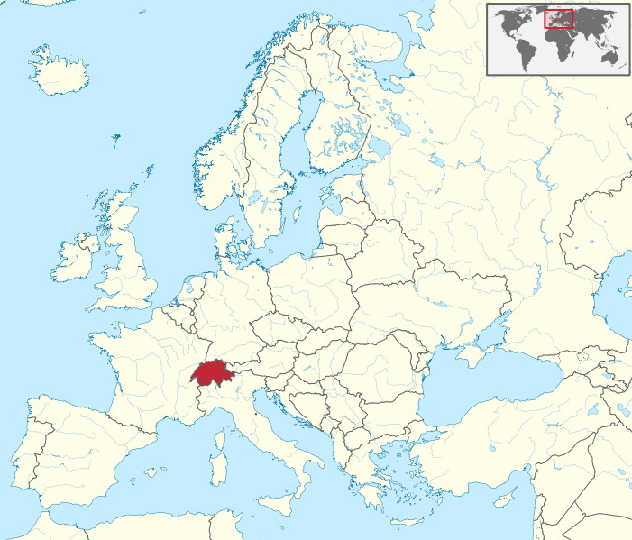
Floras in Switzerland (cantons)
Canton of Zurich: last Flora 1839
City of Zurich: last Flora 2000

Slide 6
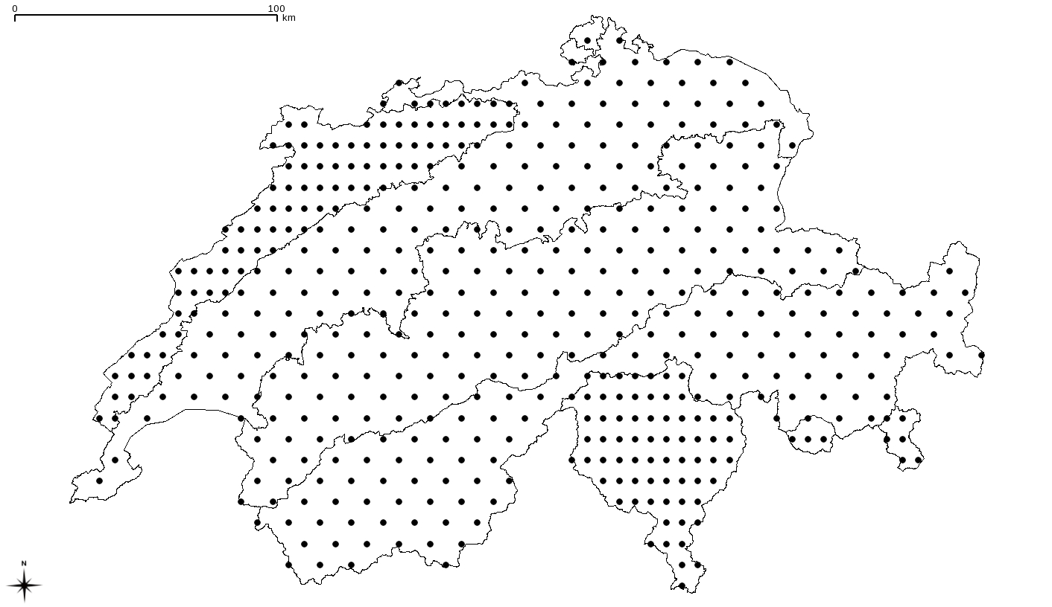
Floras to monitor environmental change: Switzerland
- Biodiversity monitoring Switzerland
Area: 1739 km2
Range: 350 – 1300 m asl
75% agriculture/forest
25% built environment
Canton of Zurich
Zurich
➡ Same area sizes, sample census
Weber et al. (2004) Global Ecol. Biogeogr.

Slide 7
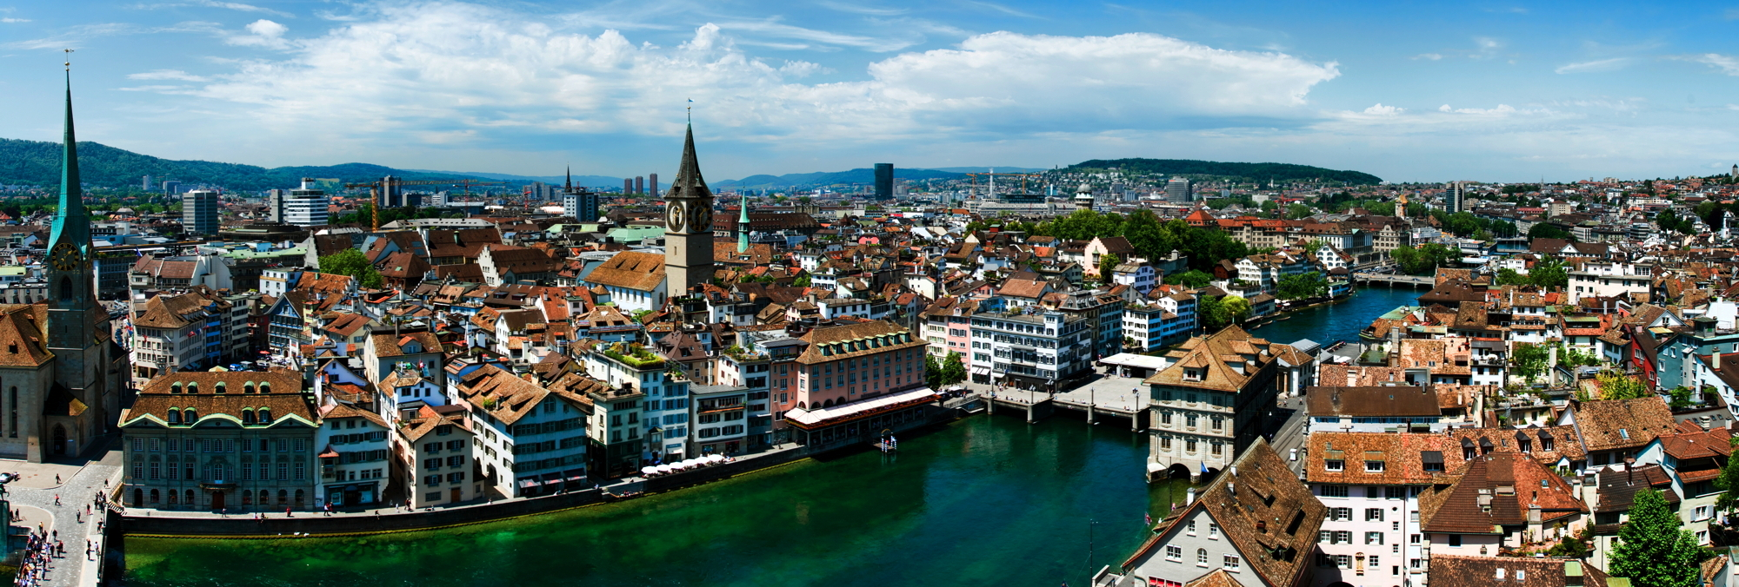
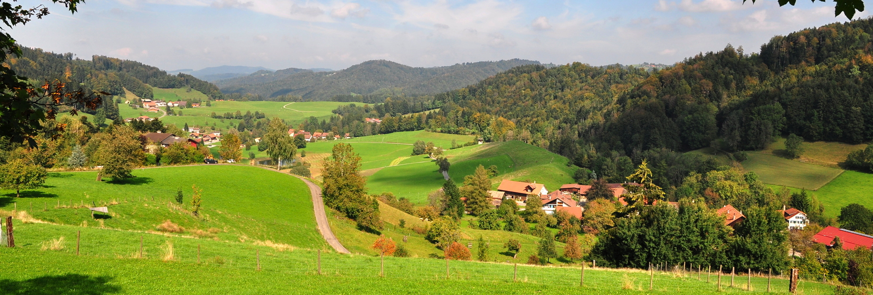
Canton Zurich
400 m a.s.l.
900 m a.s.l.

Slide 8
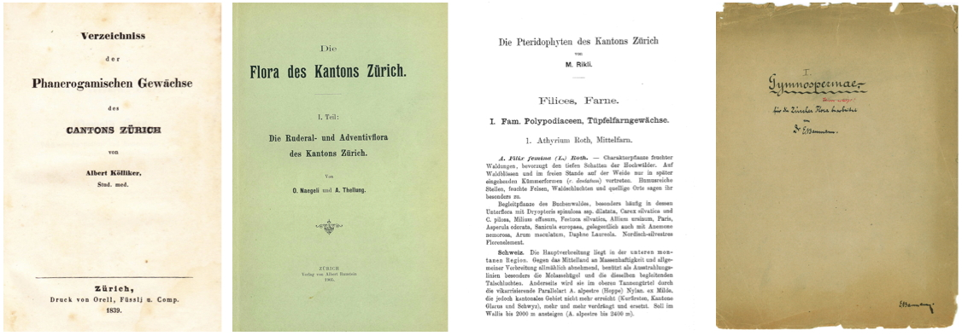
The Zurich floras
1839
1905
1912
1915
The Complete
Pre-industrial
No fertilizers
The Aliens
The Ferns
The Incomplete
➡ High time for a new flora
... but how to organise?

Slide 9
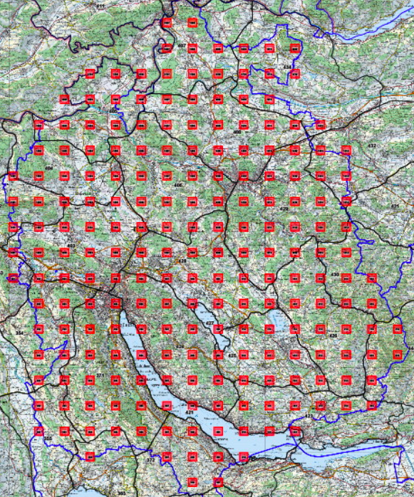
Step 1: what is the question?
Scientific Aims
To map the flora within 5 years (snap-shot)
To establish a representative view
To estimate species abundances
To explore species rarity and commonness
To detect spatio-temporal flora changes
To explore species ranges at the mesoscale
Popular Aims
To spread botany knowledge
To sensibilize people to species change
To sensibilize people to area loss
Methods
Sample 1: 209 square plots ( 1 km²)
Sample 2: 25 landscape plots (ca. 100 km²)
Integration of many volunteers
=> citizen science
Citizen science
Scientific research conducted, in whole or in part, by amateur or nonprofessional scientists

Slide 10
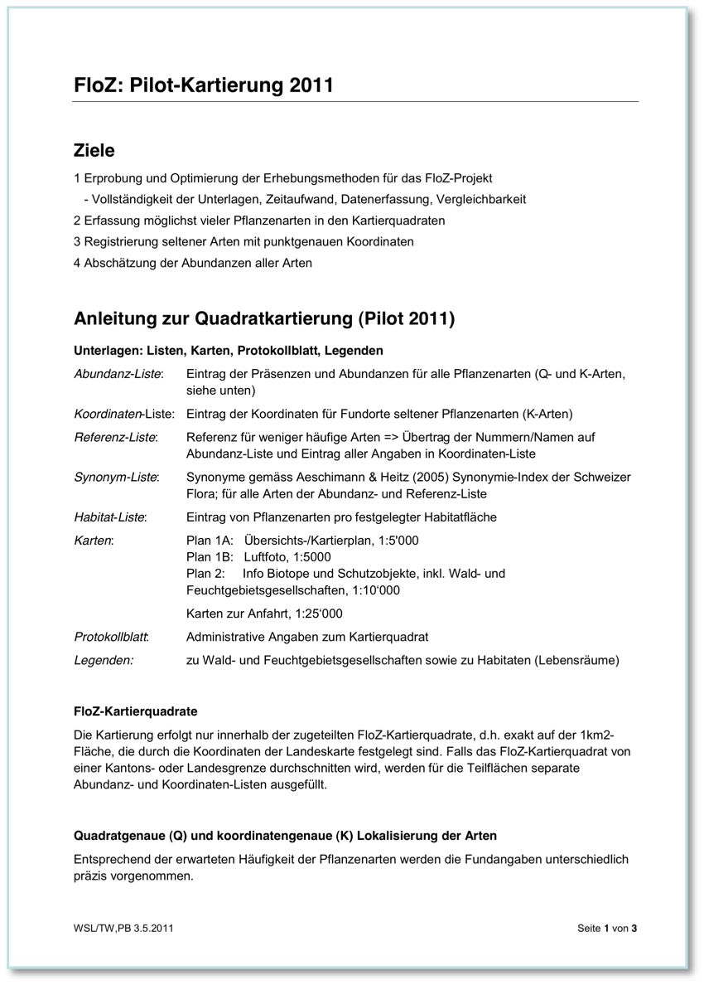
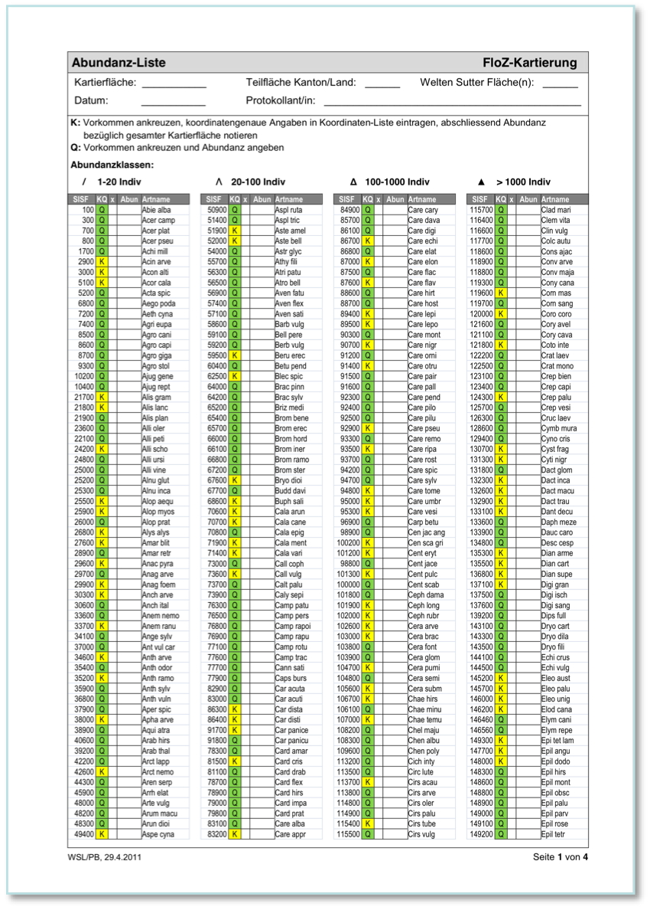
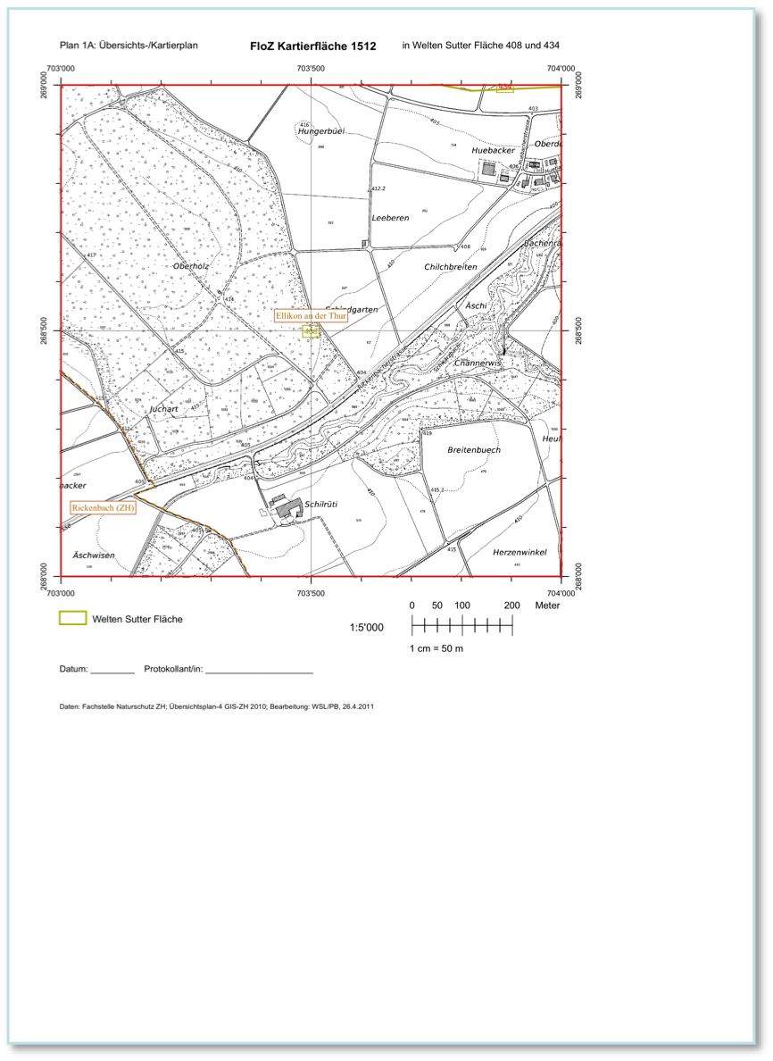
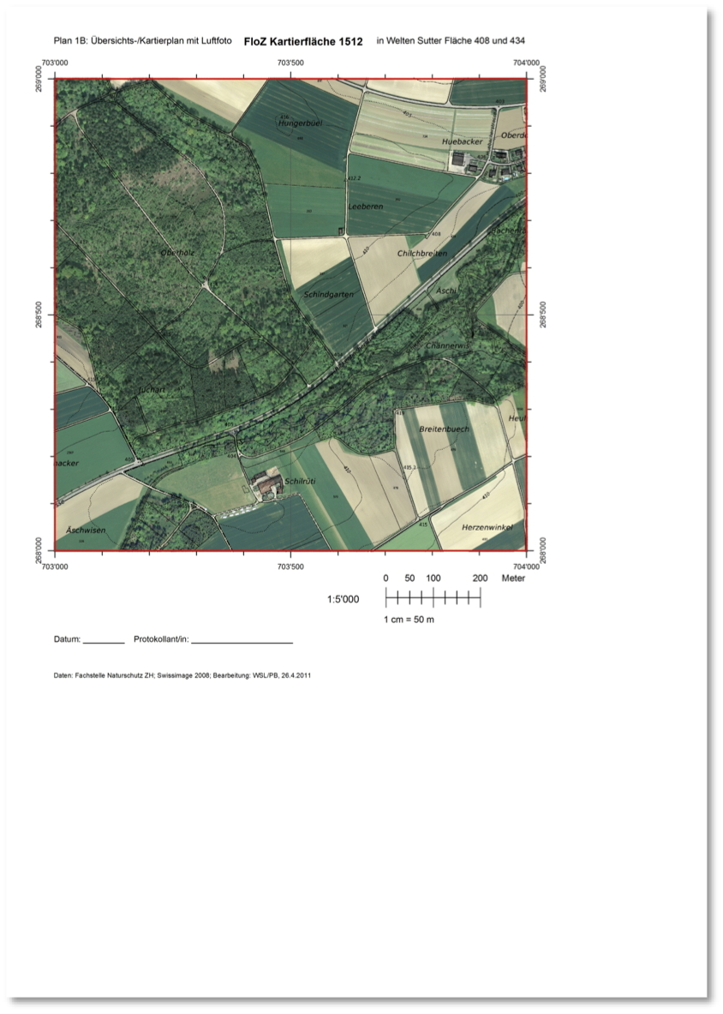
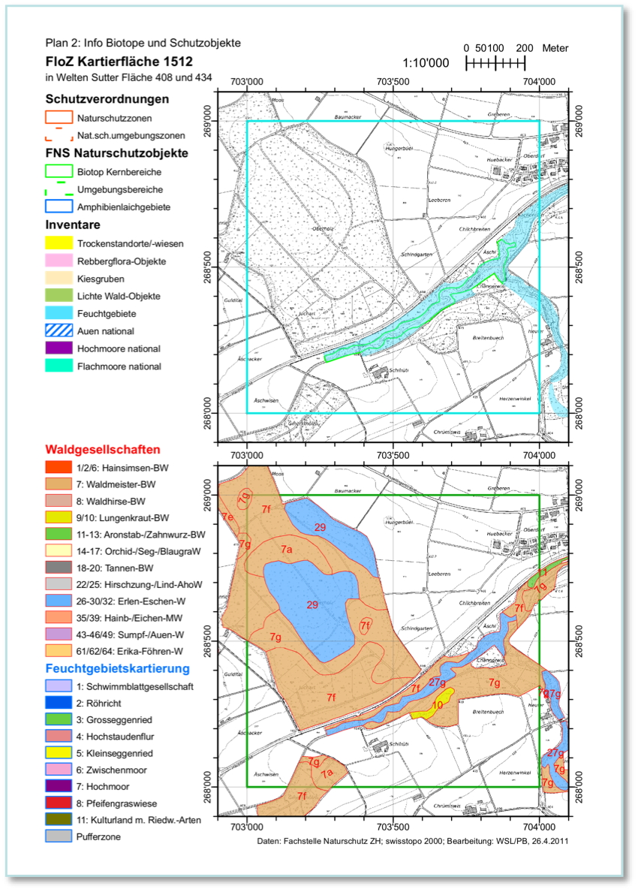
Step 2: pilot mapping

Slide 11
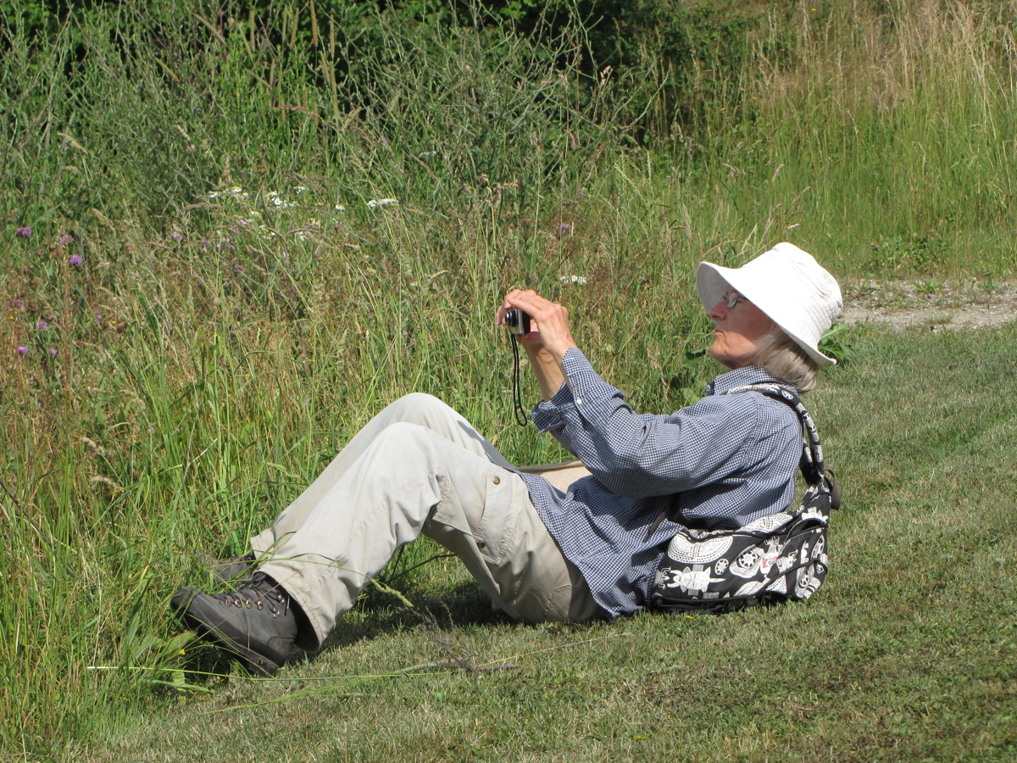
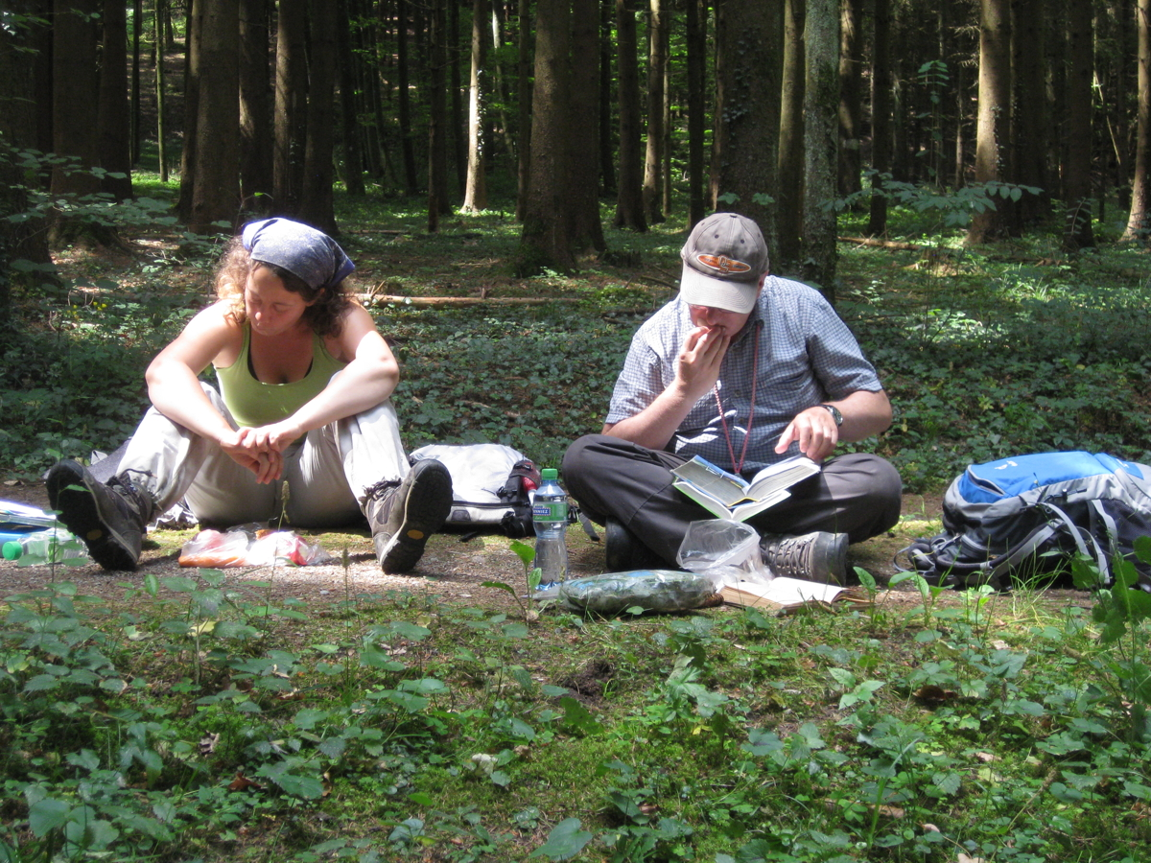
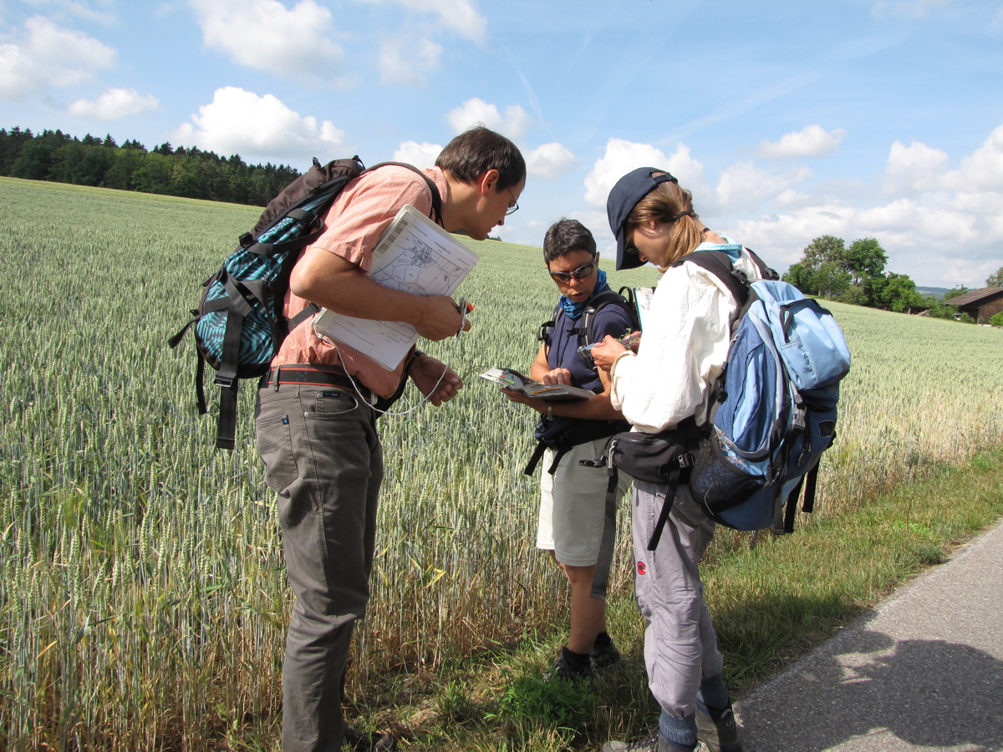
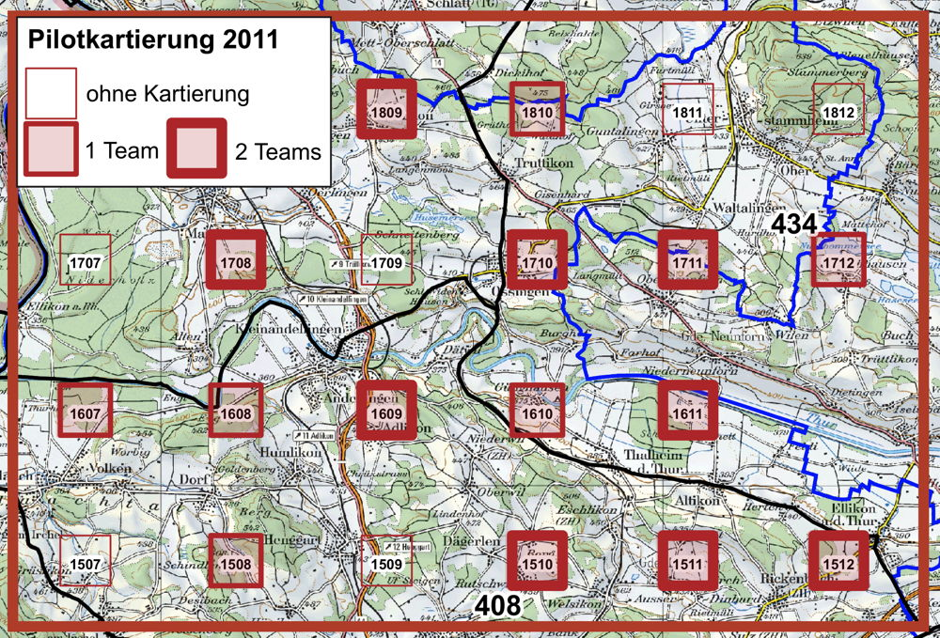
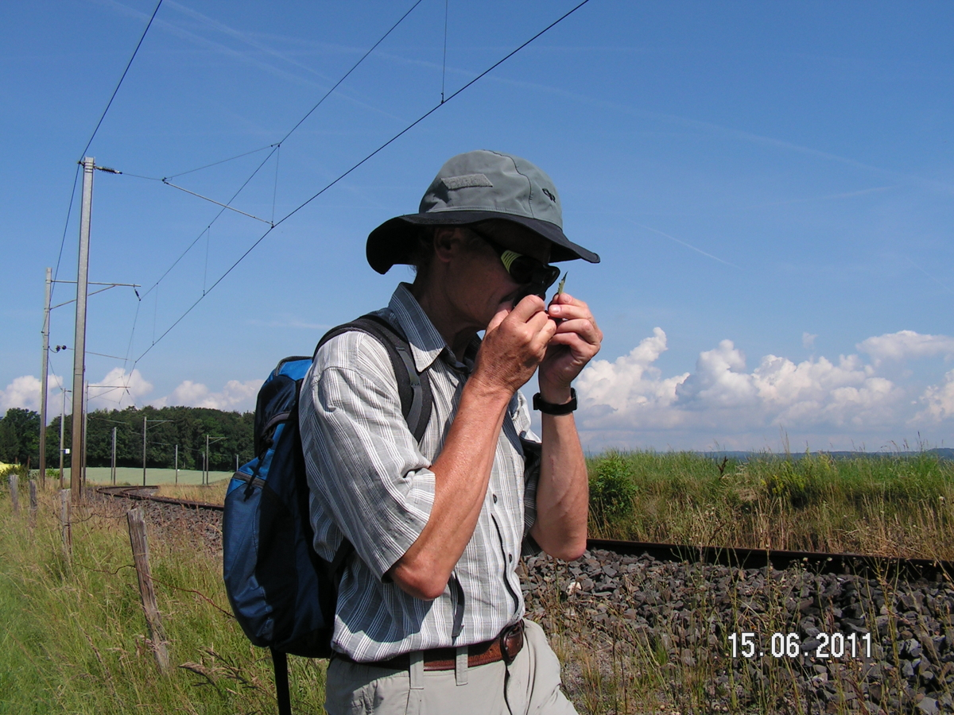
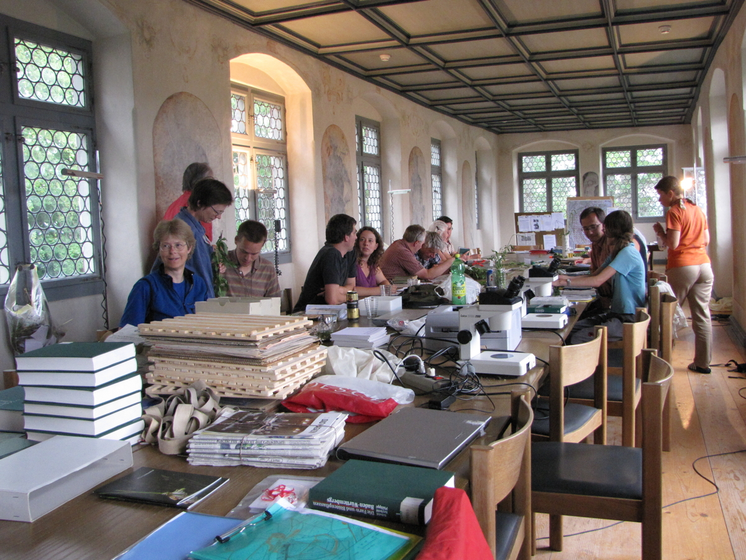
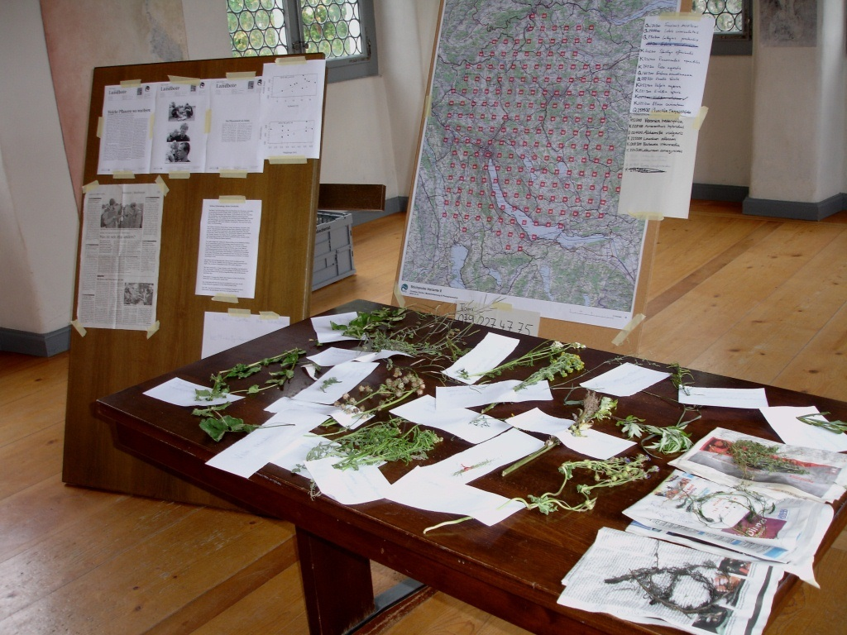
Pilot mappings: Flora camps 2011 and 2012
Pilot mapping 2011

Slide 12
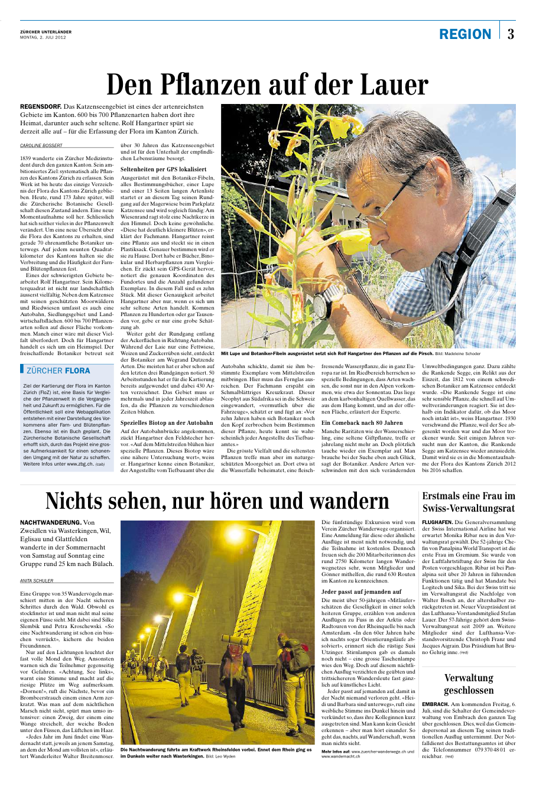
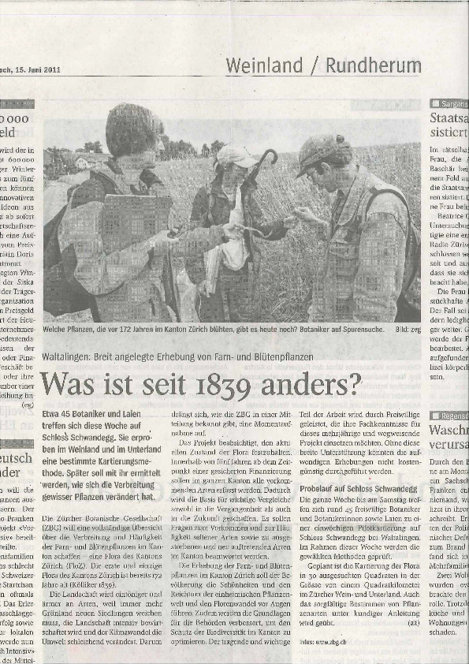
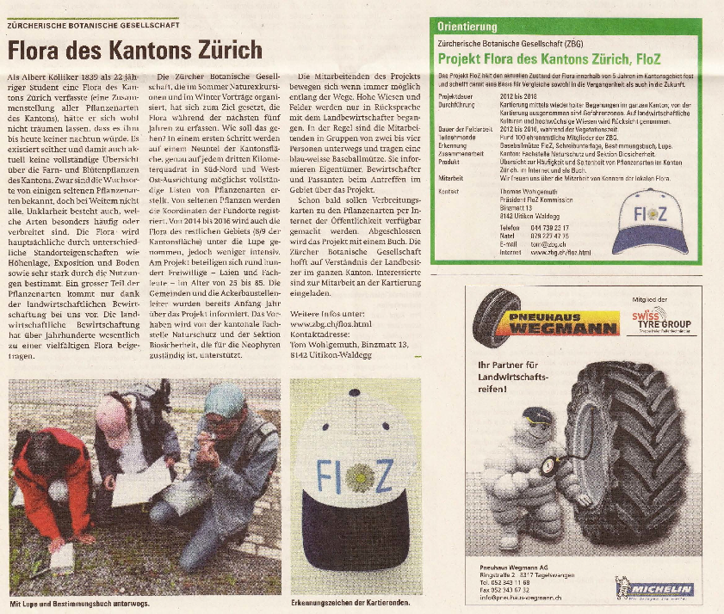
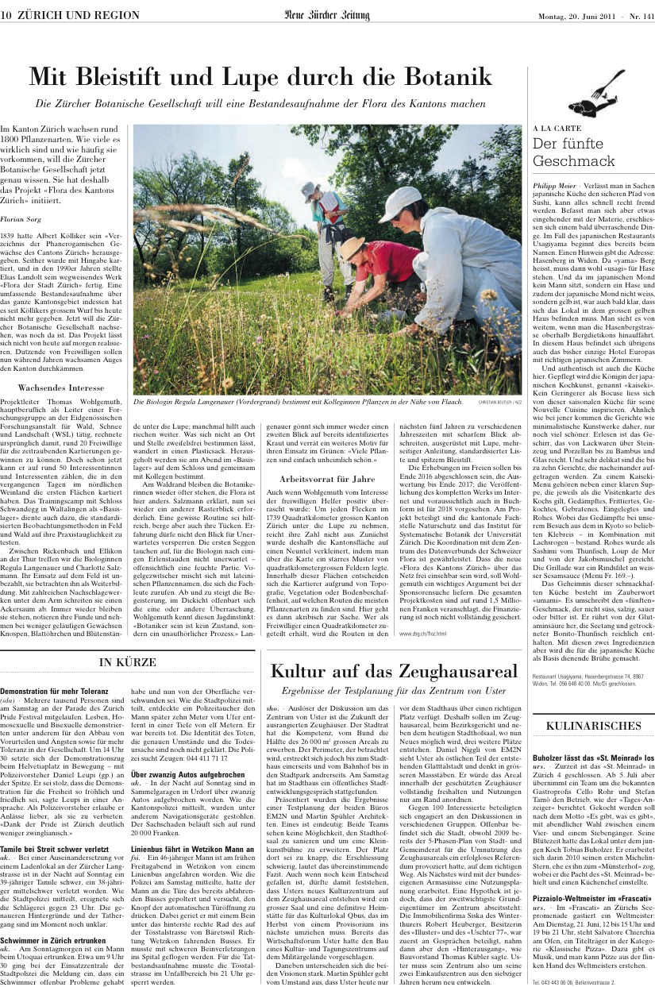
Advertising: by newpaper reports

Slide 13
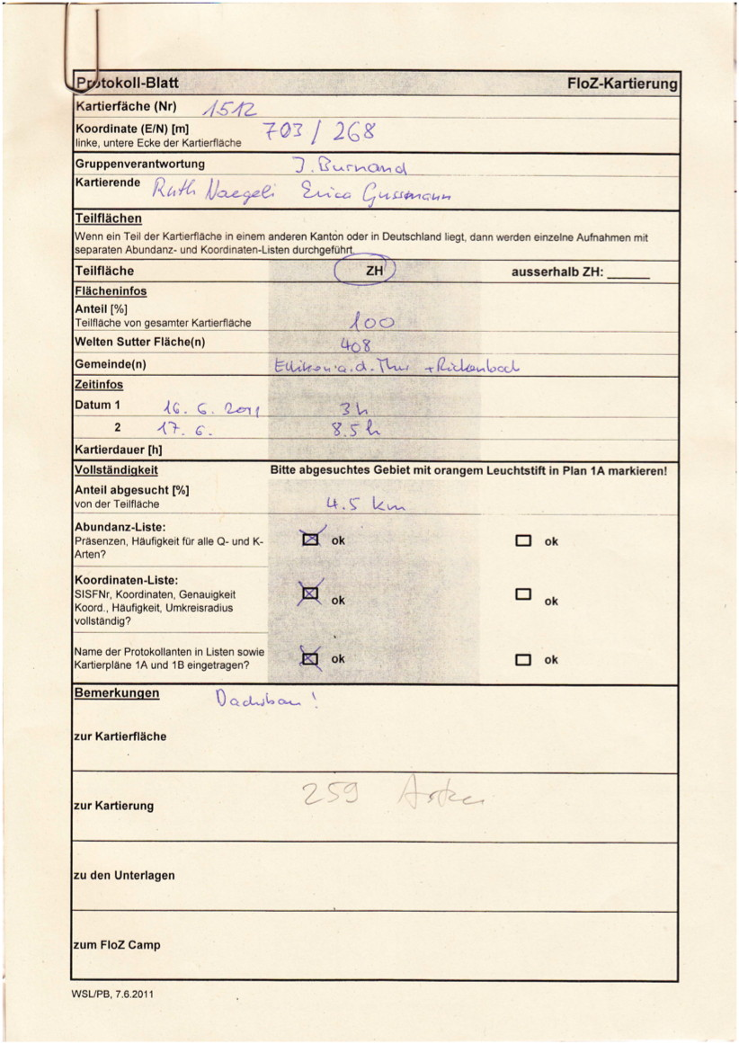
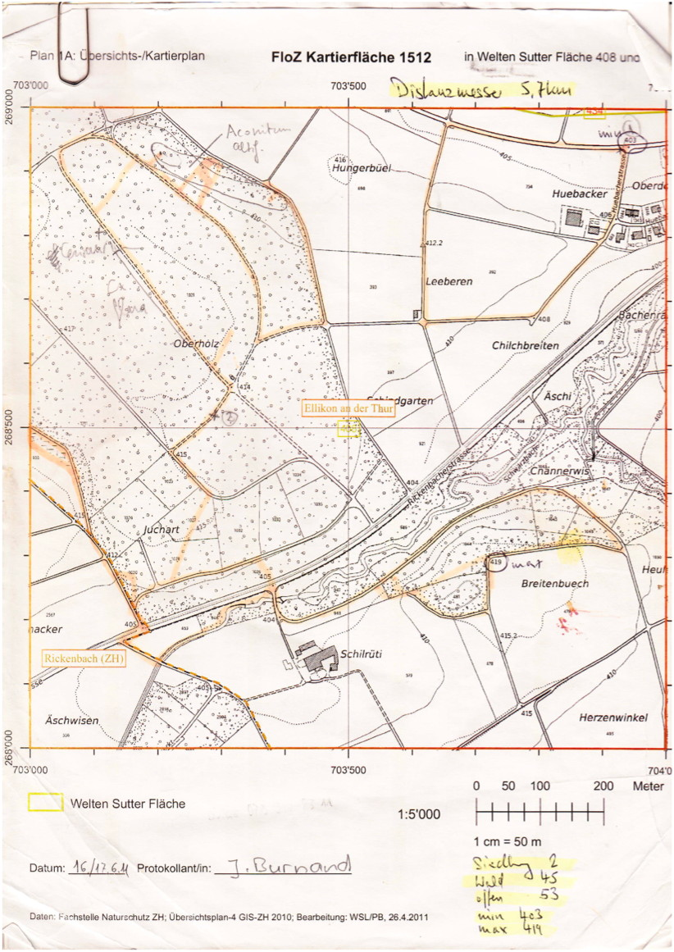
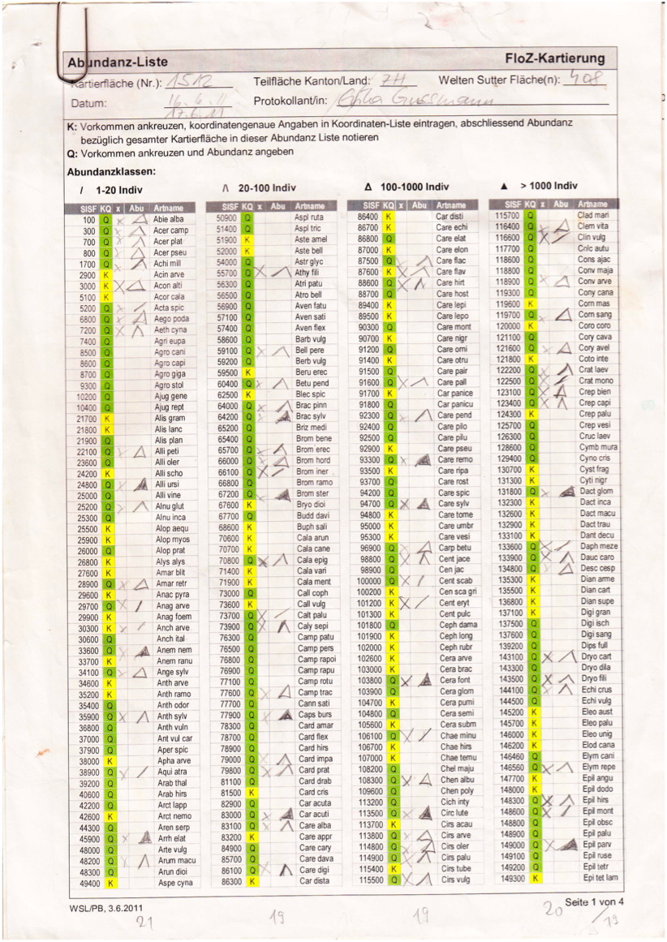
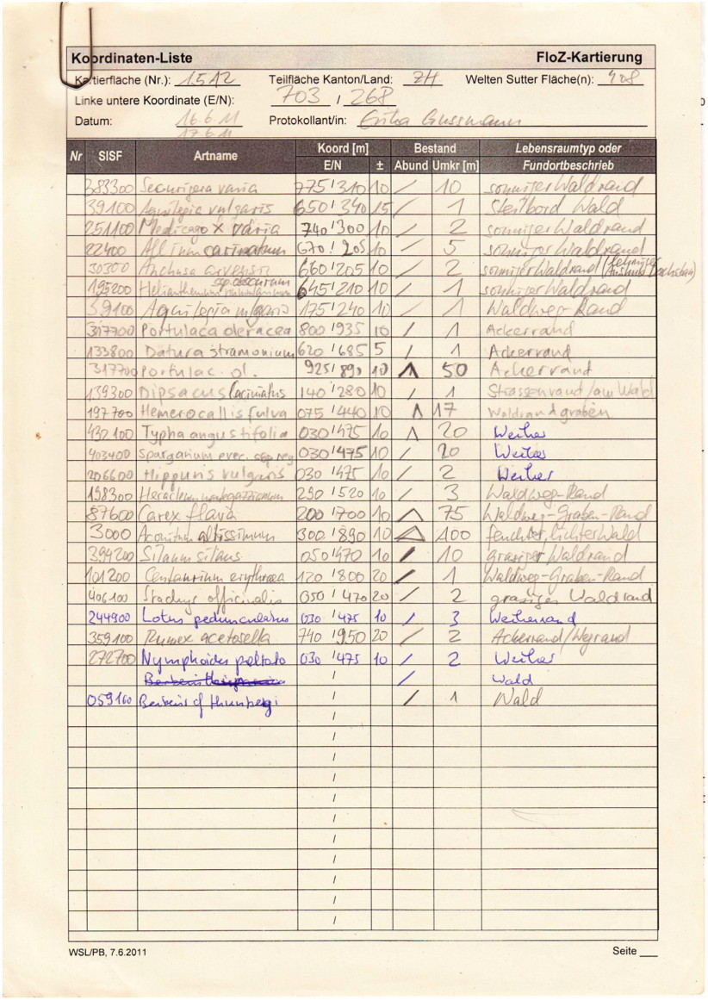
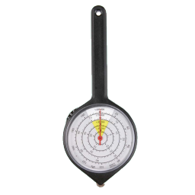
Step 3: Analsyis of results from pilot mapping

Slide 14
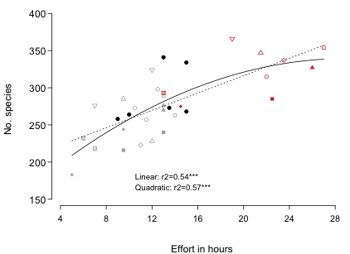
Definition of methods: Length of stay
Concordance of
species lists:
66 – 89%
Conclusion:
Lenght of stay is crucial

Slide 15
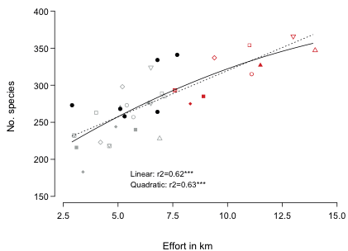
Definition of methods: Walking distance
Conclusion:
Walking distance is even more crucial

Slide 16
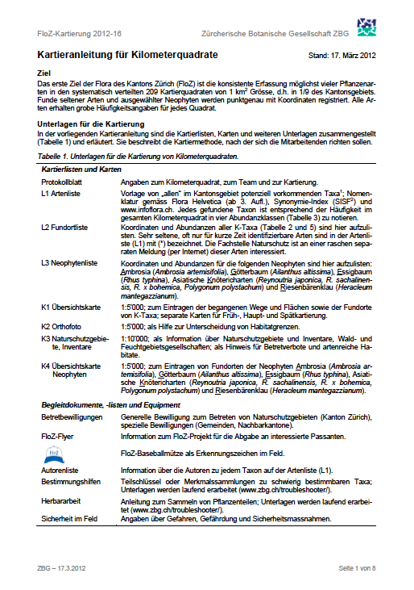
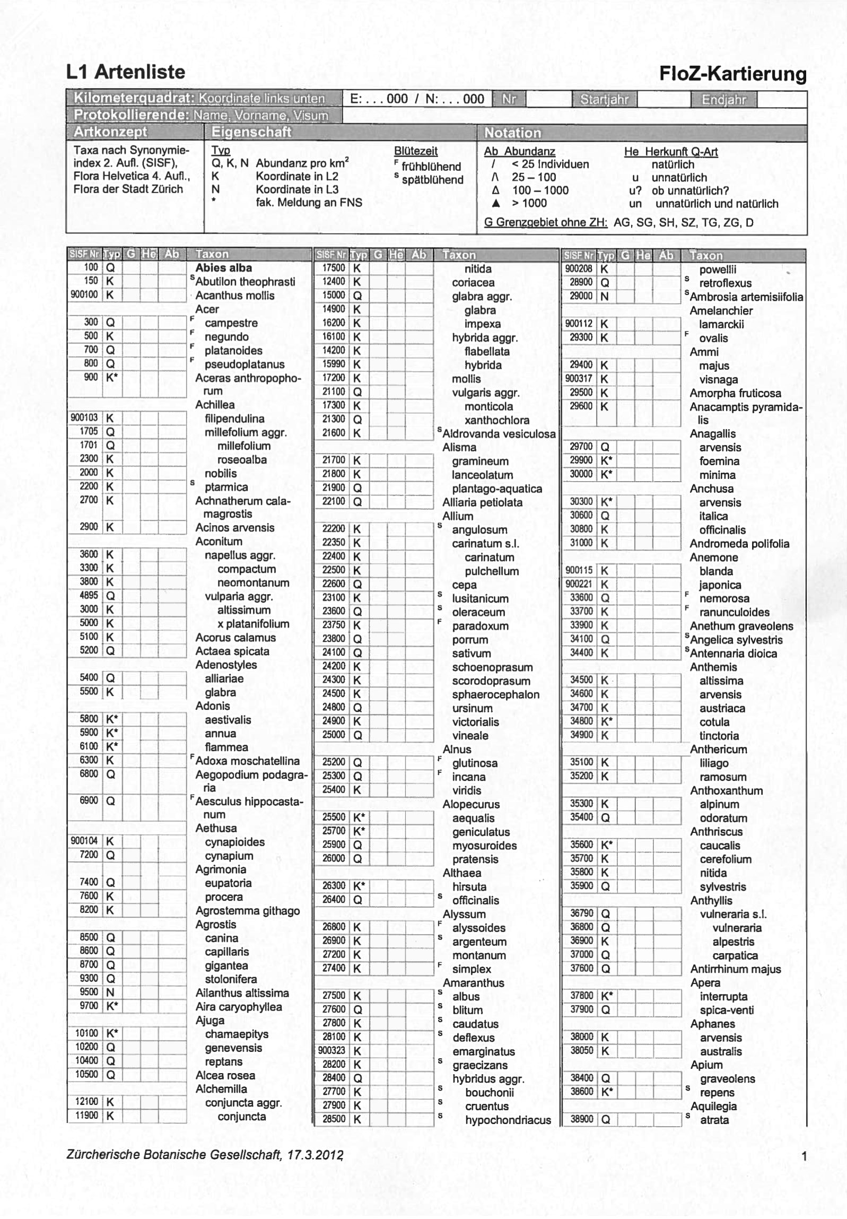
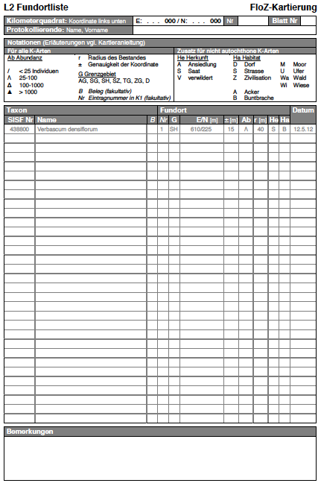
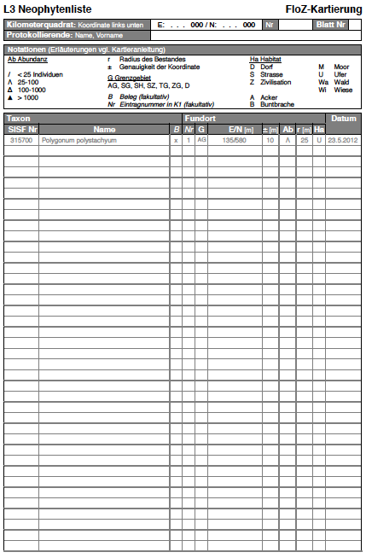
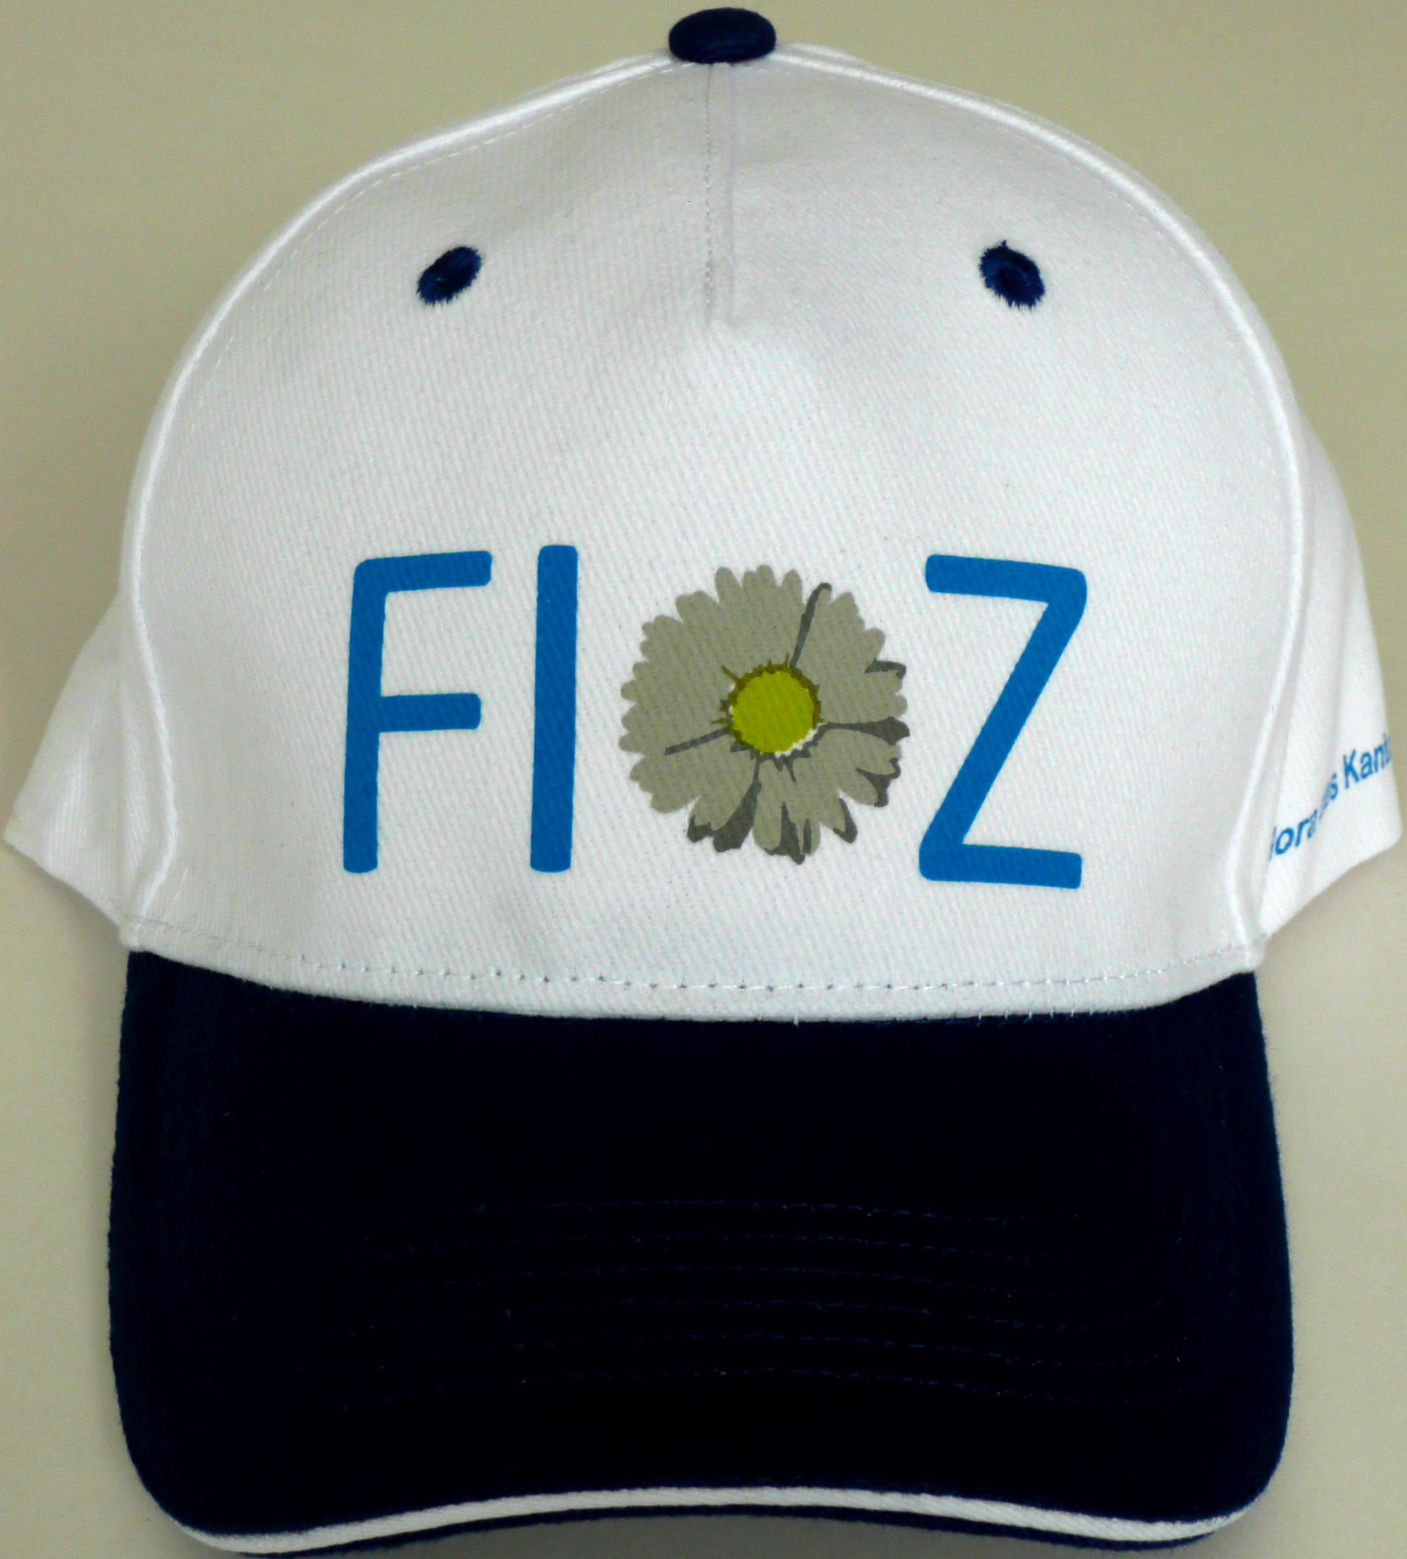
Step 4: Revision of mapping manual (March 2012)

Slide 17
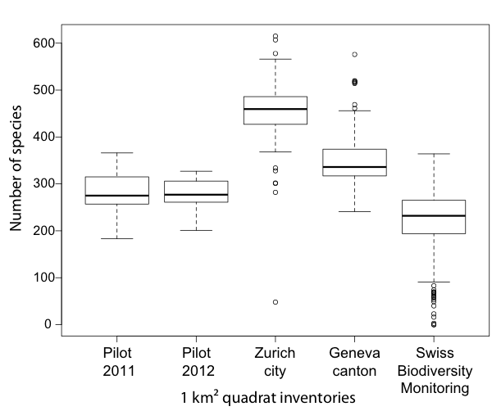
Further steps: Quality checks
450 species
Result of 15 yrs
mapping
?
Per quadrat
40-60 hours
15-30 km
2 years
3 hikes/yr
2-4 persons
Annual checks

Slide 18
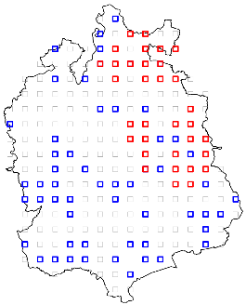
State of the art: 30% of quadrats being mapped in year 1
51 quadrats by volunteers
33 quadrats by camp volunteers
==
84 quadrats (40%) in process
70 botanists involved
Camp 2011
Collaboration with
- University of Zurich
- Kanton of Zurich: nature agency
- Swiss research institute
- National flora grid
Camp 2012
People to include
- 179 communities
- ca. 5000 farmers
- local agencies of
forestry and nature conservation

Slide 19
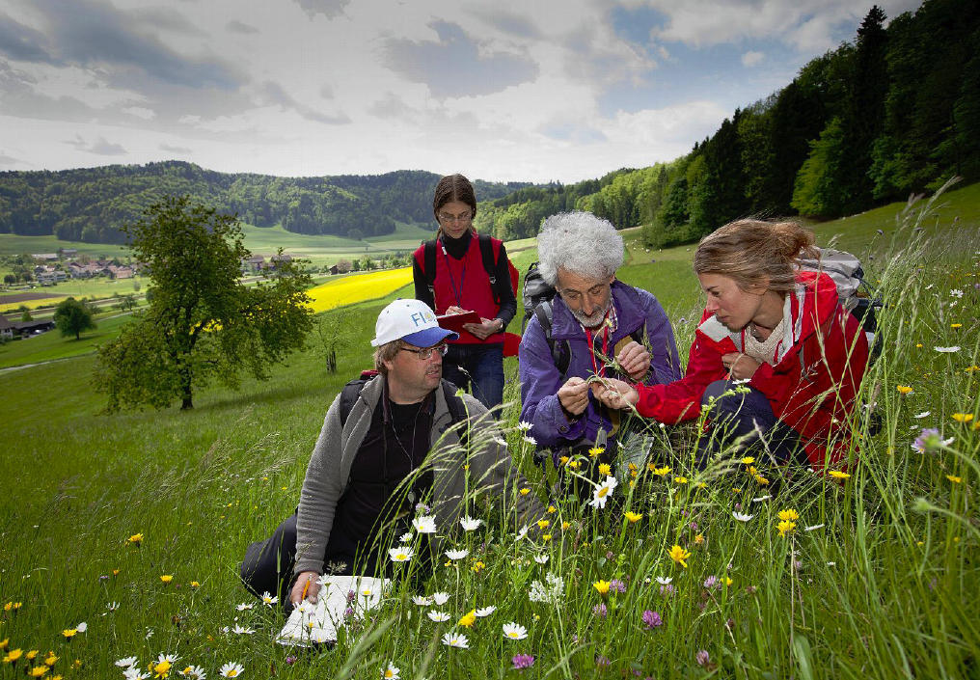
Keeping track

