Slide 1


Factors influencing tree regeneration after wind disturbance in temperate and boreal forests of Switzerland (Central Europe)
Kathrin Priewasser¹
Thomas Wohlgemuth¹
Hansheinrich Bachofen¹
Peter Brang¹
Barbara Moser¹
Harald Bugmann²
¹ Swiss Federal Institute for Forest, Snow and Landscape Research,
WSL, Birmensdorf, Switzerland
² Institute of Terrestrial Ecosystems, ETH Zürich, Switzerland

Slide 2
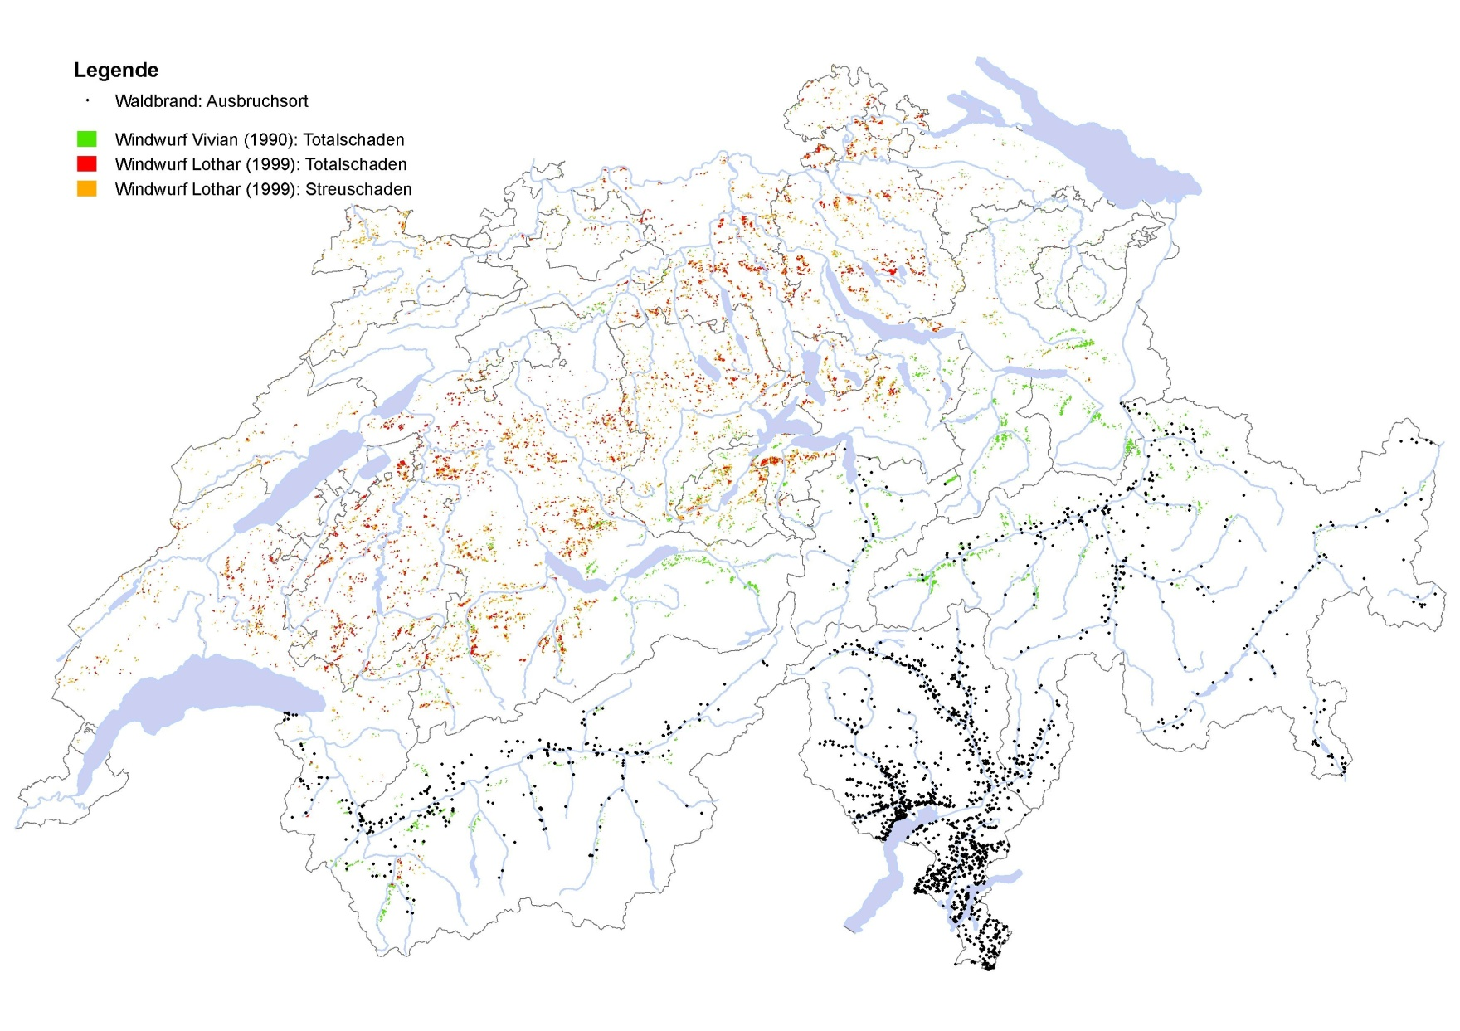
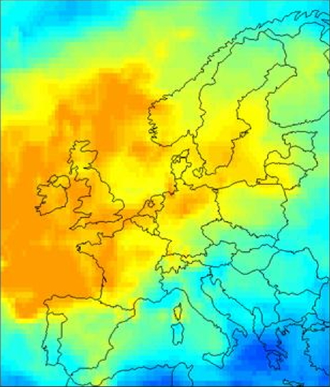
Storms are the most important disturbance in Central Europe
Introduction
Methods
Results
Conclusion
Lothar: total damage
Lothar: partial damage
Vivian: total damage
Probability to be hit by maximum wind gusts once in 50 years
80 %
Fires
60 %
40 %
20 %
Lemcke (2000; Swiss Re)
Wohlgemuth et al. (2008) Schweiz. Z. Forstwes.

Slide 3
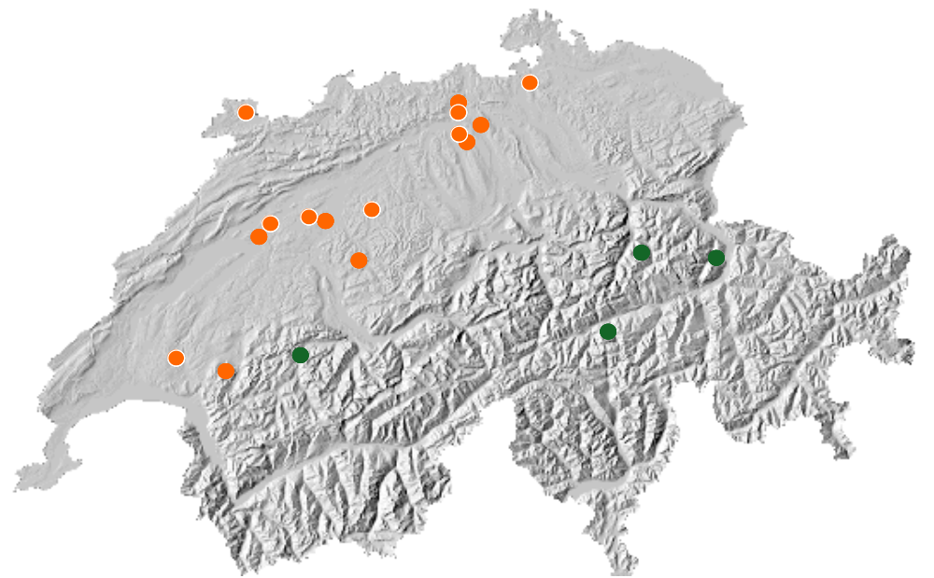
Motivation
Introduction
Methods
Results
Conclusion
Lothar sites: Research from 2002-2010
Vivian sites: Research from 1992-2005
Wohlgemuth et al., 2008, Schweiz. Z. Forstwes.

Slide 4
Research question
Introduction
Methods
Results
Conclusion
Which factors hinder or favour post-storm natural tree regeneration?

Slide 5
Selection criteria of the disturbed forest areas
Introduction
Methods
Results
Conclusion
At least 3 ha (~7.4 acres) in size
Total damage (all trees blown down)
Forests with similar tree species composition before the storm (beech, fir-beech, fir-Norway spruce or Norway spruce forests)

Slide 6
Field design: disturbed site
Introduction
Methods
Results
Conclusion
1280 m a.s.l.
20
1260
40
20
40
80
80
1240
1220
Forest edge

Slide 7
Field design: circle plot
Introduction
Methods
Results
Conclusion
Circle plot: 20 m² below 1200 m a.s.l.
50 m² above 1200 m a.s.l.
1 x 1 m or 2.5 x 2.5 m
all woody species (except seedlings)
r = 2.52 m or 3.99 m
all woody species ≥ 0.2 m

Slide 8
Recorded variables (1)
Introduction
Methods
Results
Conclusion
Tree regeneration
  tree species
  height
  dbh at 1.3 m height
  browsing damage (y/n)
  establishment (pre-/post-storm)
Soil properties
  organic soil pH
  mineral soil pH
  thickness of organic layer [cm]
Dead wood
Dependent variable
  stem density ha⁻¹

Slide 9
Recorded variables (2)
Introduction
Methods
Results
Conclusion
Vegetation cover
20
Distance to forest
edge [m]
40
...…...................................
41 points recorded
20
40
80
80
...…...................................
.
41 points recorded
Forest edge

Slide 10
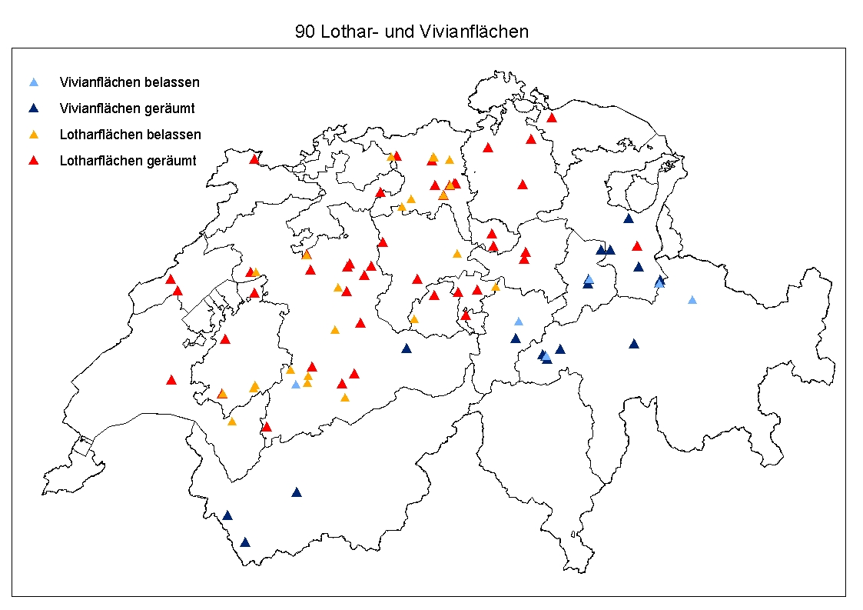
90 wind disturbed forest areas
Introduction
Methods
Results
Conclusion
Vivian sites unsalvaged
Vivian sites salvage-logged
Lothar sites unsalvaged
Lothar sites salvage-logged

Slide 11
Stem densities in 2010
Introduction
Methods
Results
Conclusion
30%
10%
Notes:
Post-storm tree regeneration:
Lothar 6‘941, Vivian 3’614; Number of post-storm regenerated trees on the 10 years old Lothar sites was significantly higher than on the 20 years old Vivian sites (ANOVA: F_{1,87} = 4.44, P = 0.038)

Slide 12
Variables included in the statistical analyses
Introduction
Methods
Results
Conclusion
Site data: n=90
GLM analyses
Plot data: n=90*6
Linear mixed effects models
ALT = altitude
pH = organic or mineral pH
EXP = aspect (N, S, E, W, no)
SLO = slope
VEG = vegetation cover
YRS = years since disturbance
ORG= organic layer
BR = % browsed trees
ALT = altitude
pH = organic or mineral pH
EXP = aspect (N, S, E, W, no)
SLO = slope
VEG = vegetation cover
YRS = years since disturbance
ORG= organic layer
DIS = distance to forest edge

Slide 13
Factors favoring or hindering tree regeneration (1)
Introduction
Methods
Results
Conclusion
→ In the GLM analyses these are the 4 most important variables explaining regeneration variation: soil pH, vegetation cover, altitude and treatment.
Notes:
For example, alone in the Lothar beech forests soil pH and vegetation cover explain 73% of the total regeneration variation!!

Slide 14
Factors favoring or hindering tree regeneration (2)
Introduction
Methods
Results
Conclusion
GLM analyses: Including only Vivian forests
One additional important variable
→ BR = % browsed trees
BR interacts with treatment
→ a significantly higher proportion of browsed trees on salvage-logged than unsalvaged areas

Slide 15
Factors favoring or hindering tree regeneration (3)
Introduction
Methods
Results
Conclusion
 | explanation variables
data set | BR | ALT | TRT salvage-logged | soil pH | VEG | D²
Vivian | — | — | + | + |  | 0.45
Lothar: Fir-beech |  | — | + | + |  | 0.43
Lothar: All sites |  | — | + | + | — | 0.41
Lothar: Spruce |  | + | + |  | — | 0.64
Lothar: Fir-spruce |  |  |  | + |  | 0.64
Lothar: Beech |  |  |  | + | — | 0.73

Slide 16
Factors favoring or hindering tree regeneration (4)
Introduction
Methods
Results
Conclusion
Plot data analyses
Most important variables: soil pH and vegetation cover
One additional weakly significant variable: Distance to forest edge
→ higher regeneration densities near the forest edge than within the disturbed area

Slide 17
Conclusion
Introduction
Methods
Results
Conclusion
First finding after Vivian and Lothar research studies
→ higher regeneration densities at lower altitudes
Our results show a weak influence of altitude on sapling density
→ interaction between ALT and soil pH → soil pH is more important than ALT

Slide 18
Conclusion
Introduction
Methods
Results
Conclusion
Sapling density increases
with high soil pH,
with low vegetation cover,
at low altitudes and
on salvage-logged sites.
=> but high heterogeneity!!

Slide 19
Outlook
Introduction
Methods
Results
Conclusion
Do wind disturbed areas that did not follow the general trends just have a delay in succession and therefore adjust with time? And if yes, how long does it take?

Slide 20
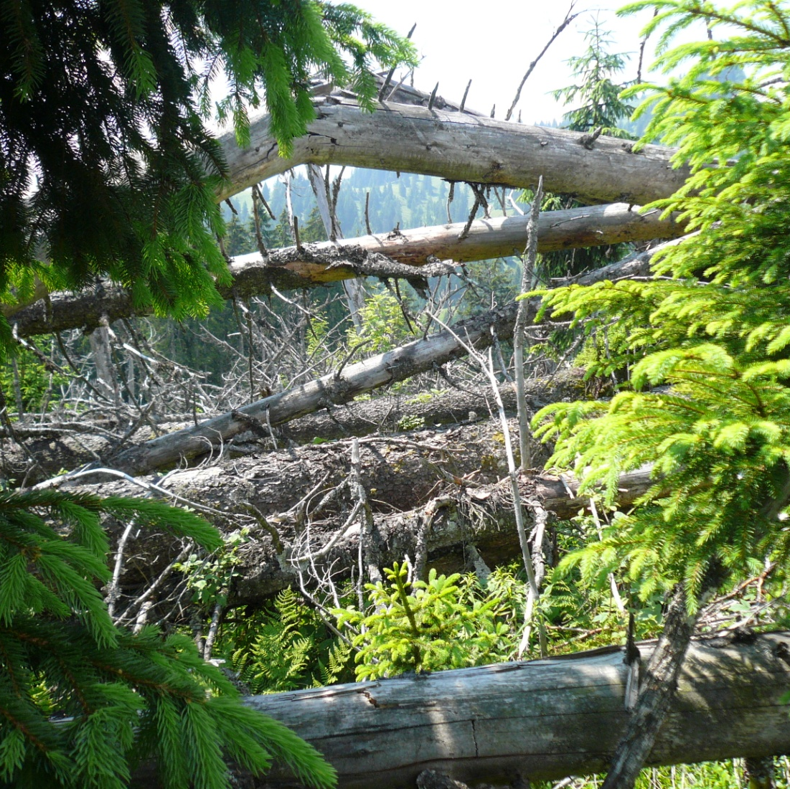
I thank you for your attention!!
Kathrin Priewasser
E-Mail:
kathrin.priewasser@wsl.ch
Picture: Hansheinrich Bachofen
Notes:
and will now be happy to answer any further questions you may have.

Slide 21
Tree species composition divided by forest types (Lothar)

Slide 22
Tree species composition (Vivian)

Slide 23
GLM results for the Lothar and Vivian data set
Vivian & Lothar: N=89 |  |  |  |  |  | Vivian: N=24 |  |  |  | Lothar: N=65
response var.
 | # | Explanatory var. | D² | AIC |  | Explanatory var. | D² | AIC |  | Explanatory var. | D² | AIC
reg_{lig} | 1 | ALT | 0.083 | 1740 |  | EXP° | 0.095 | 446 |  | pH_{O} | 0.248 | 1276
 |  | pH_{O} | 0.195 | 1727 |  |  |  |  |  | VEGfb | 0.335 | 1267
 |  | VEG_{fb} | 0.239 | 1722
 | 2 | ALT* VEG_{fb} | 0.282 | 1718 |  | pH_{M}° TRT* | 0.178 | 446 |  | pH_{O} VEG_{fb} | 0.395 | 1262
 |  | pH_{O} VEG_{fb} | 0.296 | 1716 |  | ALT* pH_{M}* | 0.199 | 445
 |  | ALT pH_{O} | 0.317 | 1713
 | 3 | BR° pH_{O} ALT | 0.344 | 1712 |  | TRT° ALT* pH_{M}* | 0.287 | 444 |  | TRT° pH_{O} VEG_{fb} | 0.417 | 1262
 |  | TRT* pH_{O} ALT | 0.352 | 1710
 |  | VEG_{fb} pH_{O} ALT | 0.374 | 1707
 | 4 | BR* TRT pH_{O} ALT | 0.395 | 1706 |  | BR* TRT ALT pH_{M} | 0.445 | 440
 |  | TRT* VEG_{fb} pH_{O} ALT | 0.406 | 1704

Slide 24
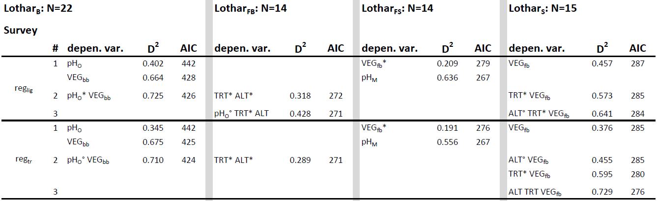
GLM results for the 4 Lothar forest types

Slide 25
Altitude against mineral soil pH

